Slide 1

Notes:
Welcome to this Organizational Behavior course that uses the 17th edition of the textbook, Organizational Behavior by Robbins and Judge. This is considered among the most widely used OB textbooks in the world. Robbins and Judge are recognized as definitive aggregators of OB concepts, applications, and practices. The course and this book will provide you with a resource that will benefit you throughout your degree program and your professional life.

Slide 2

12
Leadership
Notes:
Chapter 12: Leadership

Slide 3
Learning Objectives
Summarize the conclusions of trait theories of leadership.
Identify the central tenets and main limitations of behavioral theories.
Contrast contingency theories of leadership.
Describe the contemporary theories of leadership and their relationship to foundational theories.
Discuss the roles of leaders in creating ethical organizations.
Describe how leaders can have a positive impact on their organizations through building trust and mentoring.
Identify the challenges to our understanding of leadership.
Notes:
After studying this chapter, you should be able to:
Summarize the conclusions of trait theories of leadership.
Identify the central tenets and main limitations of behavioral theories.
Contrast contingency theories of leadership.
Describe the contemporary theories of leadership and their relationship to foundational theories.
Discuss the roles of leaders in creating ethical organizations.
Describe how leaders can have a positive impact on their organizations through building trust and mentoring.
Identify the challenges to our understanding of leadership.

Slide 4


Summarize the Conclusions of Trait Theories of Leadership
LO 1
Leadership is the ability to influence a group toward the achievement of a vision or set of goals.
Not all leaders are managers, nor are all managers leaders.
Nonsanctioned leadership is often as important or more important than formal influence.
1
Notes:
Leadership is the ability to influence a group toward the achievement of a vision or set of goals. The source of this influence may be formal, such as that provided by managerial rank in an organization. But not all leaders are managers, nor, for that matter, are all managers leaders. Just because an organization provides its managers with certain formal rights is no assurance they will lead effectively.
Nonsanctioned leadership—the ability to influence that arises outside the formal structure of the organization—is often as important or more important than formal influence. In other words, leaders can emerge from within a group as well as by formal appointment.

Slide 5
Summarize the Conclusions of Trait Theories of Leadership
LO 1
Trait theories of leadership focus on personal qualities and characteristics.
The search for personality, social, physical, or intellectual attributes that differentiate leaders from non-leaders goes back to the earliest stages of leadership research.
1
Notes:
Trait theories of leadership focus on personal qualities and characteristics. The search for personality, social, physical, or intellectual attributes that differentiate leaders from non-leaders goes back to the earliest stages of leadership research.
Early research efforts to isolate leadership traits resulted in a number of dead ends. By the 1990s, after numerous studies and analyses, about the best we could say was that most leaders “are not like other people,” but the particular traits that characterized them varied a great deal from review to review.

Slide 6
Summarize the Conclusions of Trait Theories of Leadership
LO 1
A comprehensive review of the leadership literature, when organized around the Big Five, has found extraversion to be the most important trait of effective leaders, but it is more strongly related to the way leaders emerge than to their effectiveness.
Unlike agreeableness and emotional stability, conscientiousness and openness to experience also showed strong relationships to leadership, though not quite as strong as extraversion.
1
Notes:
A comprehensive review of the leadership literature, when organized around the Big Five, has found extraversion to be the most important trait of effective leaders, but it is more strongly related to the way leaders emerge than to their effectiveness.
Sociable and dominant people are more likely to assert themselves in group situations, but leaders need to make sure they’re not too assertive—one study found leaders who scored very high on assertiveness were less effective than those who were moderately high.
Unlike agreeableness and emotional stability, conscientiousness and openness to experience also showed strong relationships to leadership, though not quite as strong as extraversion.

Slide 7

Summarize the Conclusions of Trait Theories of Leadership
LO 1
Good leaders:
Like being around people.
Are able to assert themselves (extraverted).
Are disciplined and able to keep commitments they make (conscientious).
Are creative and flexible (open).
1
Notes:
The trait approach does have something to offer. Leaders who like being around people and are able to assert themselves (extraverted), who are disciplined and able to keep commitments they make (conscientious), and who are creative and flexible (open) do have an apparent advantage when it comes to leadership, suggesting good leaders do have key traits in common. One reason is that conscientiousness and extraversion are positively related to leaders’ self-efficacy, which explained most of the variance in subordinates’ ratings of leader performance. People are more likely to follow someone who is confident she’s going in the right direction.

Slide 8



Summarize the Conclusions of Trait Theories of Leadership
LO 1
Another trait that may indicate effective leadership is emotional intelligence.
A core component of EI is empathy.
The link between EI and leadership effectiveness may be worth investigating in greater detail.
1
Notes:
Another trait that may indicate effective leadership is emotional intelligence (EI), discussed in Chapter 4. A core component of EI is empathy. A leader who effectively displays and manages emotions will find it easier to influence the feelings of followers, by both expressing genuine sympathy and enthusiasm for good performance and by using irritation for those who fail to perform.
The link between EI and leadership effectiveness may be worth investigating in greater detail. Recent research has demonstrated that people high in EI are more likely to emerge as leaders, even after taking cognitive ability and personality into account.

Slide 9




Summarize the Conclusions of Trait Theories of Leadership
LO 1
Two conclusions:
Traits can predict leadership.
Traits do a better job predicting the emergence of leaders and the appearance of leadership than actually distinguishing between effective and ineffective leaders.
1
Notes:
Based on the latest findings, we offer two conclusions. We can say that traits can predict leadership. Second, traits do a better job predicting the emergence of leaders and the appearance of leadership than actually distinguishing between effective and ineffective leaders. The fact that an individual exhibits the traits and that others consider him or her a leader does not necessarily mean the leader is successful at getting the group to achieve its goals.
Trait theories help us predict leadership, but they don’t fully help us explain leadership.

Slide 10




Central Tenets and Main Limitations of Behavioral Theories
LO 2
Behavioral theories of leadership imply we can train people to be leaders.
Ohio State Studies found two behaviors that accounted for most leadership behavior:
Initiating structure
Consideration
the extent to which a leader is likely to define and structure his or her role and those of employees in the search for goal attainment
the extent to which a person's job relationships are characterized by mutual trust, respect for employees' ideas, and regard for their feelings
1
Notes:
While trait research provides a basis for selecting the right people for leadership, behavioral theories of leadership imply that we can train people to be leaders.
The most comprehensive theories resulted from the Ohio State Studies which sought to identify independent dimensions of leader behavior. Beginning with more than a thousand dimensions, the studies narrowed the list to two that substantially accounted for most of the leadership behavior described by employees: initiating structure and consideration.
Initiating structure is the extent to which a leader is likely to define and structure his or her role and those of employees in the search for goal attainment. It includes behavior that attempts to organize work, work relationships, and goals. A leader high in initiating structure is someone who “assigns group members to particular tasks,” “expects workers to maintain definite standards of performance,” and “emphasizes the meeting of deadlines.”
Consideration is the extent to which a person’s job relationships are characterized by mutual trust, respect for employees’ ideas, and regard for their feelings. A leader high in consideration helps employees with personal problems, is friendly and approachable, treats all employees as equals, and expresses appreciation and support.

Slide 11
Central Tenets and Main Limitations of Behavioral Theories
LO 2
The GLOBE study suggests there are international differences in preference for initiating structure and consideration.
Based on the values of Brazilian employees, a U.S. manager leading a team in Brazil would need to be team-oriented, participative, and humane. Leaders high in consideration would succeed best in this culture.
1
Notes:
Some research from the GLOBE study suggests there are international differences in preference for initiating structure and consideration. For example, based on the values of Brazilian employees, a U.S. manager leading a team in Brazil would need to be team-oriented, participative, and humane. Leaders high in consideration would succeed best in this culture. As one Brazilian manager said in the GLOBE study, “We do not prefer leaders who take self-governing decisions and act alone without engaging the group. That’s part of who we are.”

Slide 12



Central Tenets and Main Limitations of Behavioral Theories
LO 2
Summary of Trait Theories and Behavioral Theories
Leaders who have certain traits and who display culturally appropriate consideration and structuring behaviors do appear to be more effective.
Traits and behaviors do not guarantee success.
Context matters too.
1
Notes:
In summary, leaders who have certain traits and who display culturally appropriate consideration and structuring behaviors do appear to be more effective. Future research is needed to integrate these approaches. As important as traits and behaviors are in identifying effective or ineffective leaders, they do not guarantee success. The context matters too.

Slide 13







Contrast Contingency Theories of Leadership
LO 3
The Fiedler contingency model: effective group performance depends upon the proper match between the leader’s style and the degree to which the situation gives control to the leader.
The least preferred coworker (LPC) questionnaire:
Task- or relationship-oriented.
Assumes leadership style is fixed.
two ways to improve leader effectiveness: you can either change the leader to fit the situation, or change the situation to fit the leader.
1
Notes:
The first comprehensive contingency model for leadership was developed by Fred Fiedler, who proposed that effective group performance depends on the proper match between the leader’s style and the degree to which the situation gives control to the leader..
The first step In the Fiedler contingency model is identifying leadership style. Fiedler believed that a key factor in leadership success is the individual’s basic leadership style. He created the least preferred coworker (LPC) questionnaire for this purpose, to measure whether a person is task- or relationship-oriented. The questionnaire contains 16 contrasting adjectives (such as pleasant-unpleasant, efficient-inefficient, open-guarded, supportive-hostile) and asks respondents to describe the one person they least enjoyed working with by rating him or her on a scale of one-to-eight for each of the 16 sets of contrasting adjectives. Fiedler believed that, based on the respondents’ answers to this questionnaire, he could determine their basic leadership style.
Fiedler’s model assumes that an individual’s leadership style is fixed. Because of that assumption, there are only two ways to improve leader effectiveness: you can either change the leader to fit the situation, or change the situation to fit the leader.

Slide 14

Contrast Contingency Theories of Leadership
LO 3
Defining the Situation
Contingency dimensions:
Leader-member relations
Task structure
Position power
degree of confidence, trust, and respect members have in their leader.
the degree to which the job assignments are procedural
degree of influence a leader has over power variables such as hiring, firing, discipline, promotions, and salary increases.
1
Notes:
After assessing leadership style, it is necessary to match the leader with the situation. Fiedler has identified three contingency or situational dimensions:
Leader-member relations—the degree of confidence, trust, and respect members have in their leader.
Task structure—the degree to which the job assignments are procedural.
Position power—the degree of influence a leader has over power variables such as hiring, firing, discipline, promotions, and salary increases.
The next step is to evaluate the situation in terms of these three contingency variables. Leader-member relations are either good or poor. Task structure is either high or low. Position power is either strong or weak. Fiedler states the better the leader-member relations, the more highly structured the job, and the stronger the position power, the more control the leader has.

Slide 15
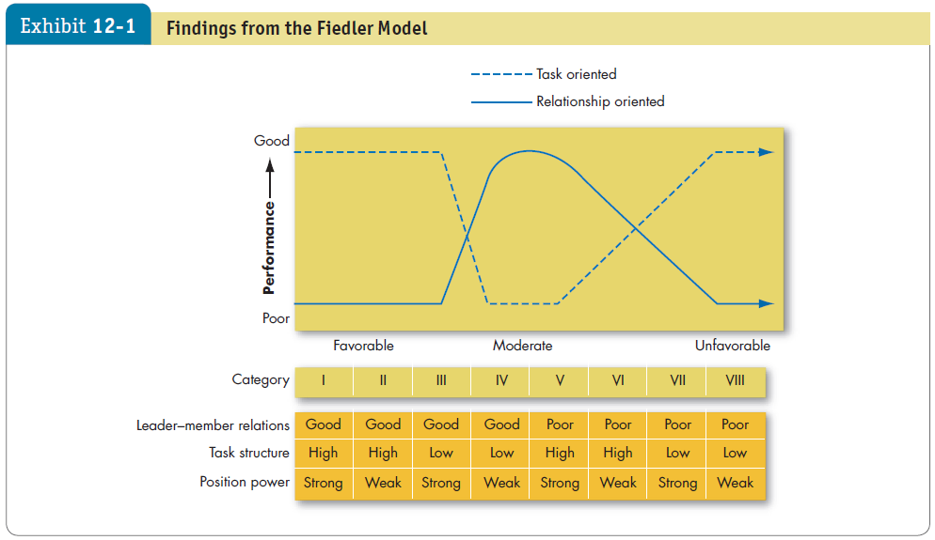
Contrast Contingency Theories of Leadership
LO 3
1
Notes:
As shown in Exhibit 12-1, Fiedler concluded that task-oriented leaders tend to perform better in situations that were very favorable to them as well as in situations that were very unfavorable. Fiedler would predict that when faced with a category I, II, Ill, VII, or VIII situation, task-oriented leaders perform better. Relationship-oriented leaders, however, perform better in moderately favorable situations—categories IV through VI. Fiedler has condensed these eight situations to three.

Slide 16



Contrast Contingency Theories of Leadership
LO 3
Situational leadership theory (SLT) is a contingency theory that focuses on the followers.
Successful leadership is achieved by selecting the right leadership style, which is contingent on the level of the followers’ readiness.
1
Notes:
Although LPC theory is the most researched contingency theory, three others deserve mention.
First, situational leadership theory (SLT) is a contingency theory that focuses on the followers. It proposes that successful leadership is achieved by selecting the right leadership style, which is contingent on the level of the followers’ readiness. The term readiness refers to “the extent to which people have the ability and willingness to accomplish a specific task.” A leader should choose one of four behaviors depending on follower readiness. If followers are unable and unwilling to do a task, the leader needs to give clear and specific directions; If they are unable but willing, the leader needs to display high task orientation to compensate for followers’ lack of ability and high relationship orientation to get them to “buy into” the leader’s desires. Conversely, if followers are able but unwilling, the leader needs to use a supportive and participative style. If they are both able and willing, the leader doesn’t need to do much.
SLT has intuitive appeal. Yet, research efforts to test and support the theory have generally been disappointing.

Slide 17

Contrast Contingency Theories of Leadership
LO 3
Path-goal theory:
Contingency model of leadership that extracts key elements from the Ohio State leadership research on initiating structure and consideration and the expectancy theory of motivation.
Derived from belief that effective leaders clarify the path to help followers achieve work goals.
1
Notes:
One of the most respected approaches to leadership is the path-goal theory, developed by Robert House. It is a contingency model of leadership that extracts key elements from the Ohio State leadership research on initiating structure and consideration and the expectancy theory of motivation.
The term “path-goal” is derived from the belief that effective leaders clarify the path to help their followers achieve their work goals. According to path-goal theory, whether a leader should be directive or supportive or should demonstrate some other behavior depends on complex analysis of the situation. The theory predicts the following: directive leadership yields greater satisfaction when tasks are ambiguous or stressful than when they are highly structured and well laid out, while supportive leadership results in high performance and satisfaction when employees are performing structured tasks. Directive leadership is likely to be perceived as redundant among employees with high ability or considerable experience.

Slide 18


Contrast Contingency Theories of Leadership
LO 3
The leader-participation model relates leadership behavior and participation in decision making.
Leader behavior must adjust to reflect the task structure.
1
Notes:
The final contingency theory is the leader-participation model which argues that the way the leader makes decisions is as important as what she or he decides. The model, developed by Victor Vroom and Phillip Yetton, relates leadership behavior and participation in decision making. Like path-goal theory, it says leader behavior must adjust to reflect the task structure.

Slide 19
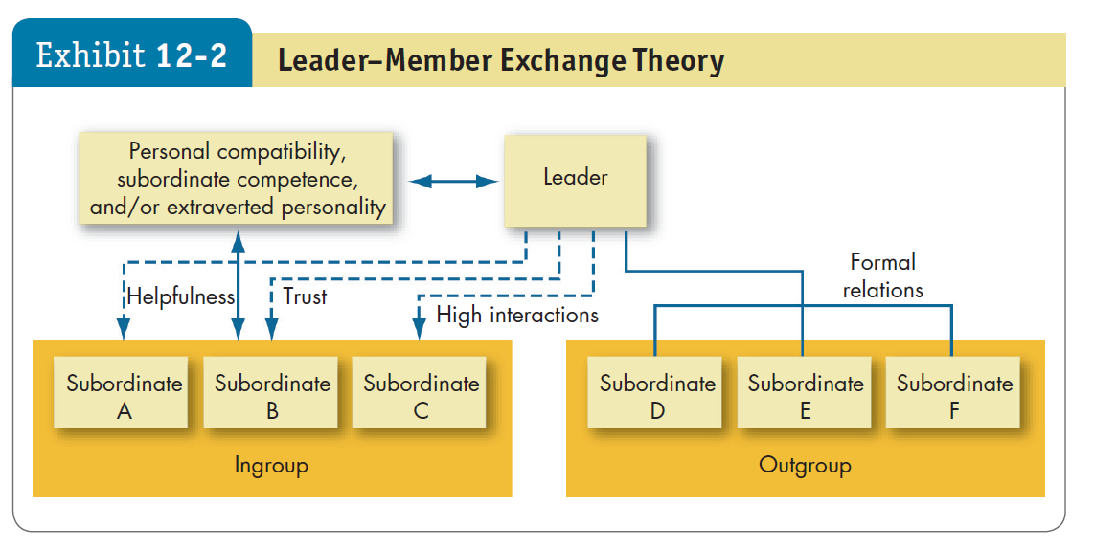
Contemporary Theories of Leadership
LO 4
1
Notes:
The leader-member exchange (LMX) theory argues that because of time pressures, leaders establish a special relationship with a small group of their followers (see Exhibit 12-2). These individuals make up the in-group—they are trusted, get a disproportionate amount of the leader’s attention, and are more likely to receive special privileges. The theory proposes that early in the history of the interaction between a leader and a given follower, the leader implicitly categorizes the follower as an “in” or an “out” and that relationship is relatively stable over time. The leader does the choosing on the basis of the follower’s characteristics.
Research to test LMX theory has been generally supportive, with substantive evidence that leaders do differentiate among followers. These disparities are far from random; and followers with in-group status will have higher performance ratings, engage in more helping or “citizenship” behaviors at work, and report greater satisfaction with their superior.
Research to test this theory has also been conducted in different cultures, including Portugal and Turkey.

Slide 20
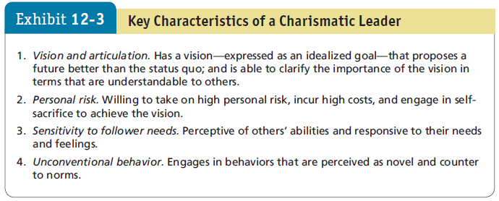




Contemporary Theories of Leadership
LO 4
1
Notes:
Charismatic leadership theory was proposed by Robert House, stating that followers make attributes of heroic or extraordinary leadership abilities when they observe certain behaviors, as seen in Exhibit 12-3. General characteristics are: they have vision; they are willing to take personal risk; they are sensitive to followers’ needs; and they exhibit extraordinary behaviors.

Slide 21


Contemporary Theories of Leadership
LO 4
Are Charismatic Leaders Born or Made?
Some individuals are born with charismatic traits, others are trained to exhibit charismatic behaviors.
Develop the aura of charisma.
Create a bond that inspires others to follow.
Bring out the potential in followers by tapping into their emotions.
1
Notes:
Are charismatic leaders born or made? Some individuals are born with traits that make them charismatic. Most experts believe individuals can also be trained to exhibit charismatic behavior.
First, an individual needs to develop the aura of charisma by maintaining an optimistic view, using passion as a catalyst for generating enthusiasm, and communicating with the whole body, not just with words. Second, an individual draws others in by creating a bond that inspires others to follow. Third, the individual must bring out the potential in followers by tapping into their emotions.

Slide 22




Contemporary Theories of Leadership
LO 4
How Charismatic Leaders Influence Followers
Articulating an appealing vision.
Developing a vision statement.
Establishing a new set of values.
Conveying courage and conviction about the vision.
1
Notes:
How does a charismatic leader influence followers? By articulating an appealing vision, developing an accompanying vision statement, conveying a new set of values, and demonstrating courage and conviction about the vision. Followers “catch” the emotions their leader is conveying.

Slide 23

Contemporary Theories of Leadership
LO 4
Does Effective Charismatic Leadership Depend on the Situation?
People are especially receptive when they sense a crisis, when they are under stress, or when they fear for their lives.
1
Notes:
Does effective charismatic leadership depend on the situation? Charisma appears to be most appropriate when the follower’s task has an ideological component or when the environment involves a high degree of stress and uncertainty. People are especially receptive when they sense a crisis, when they are under stress, or when they fear for their lives.
This may explain why, when charismatic leaders surface, it’s more likely to be in politics, religion, wartime; or when a business firm is in its infancy or facing a life-threatening crisis.

Slide 24

Contemporary Theories of Leadership
LO 4
The Dark Side of Charismatic Leadership
Many leaders don’t necessarily act in the best interest of their companies.
Many have allowed their personal goals to override the goals of the organization.
Individuals who are narcissistic are also higher in some behaviors associated with charismatic leadership.
1
Notes:
Some charismatic leaders don’t necessarily act in the best interest of their companies, allowing their personal goals to override the goals of the organization. The results at companies such as Enron, Tyco, WorldCom, and HealthSouth are examples of leaders who recklessly used organizational resources for their personal benefit and executives who violated laws and ethical boundaries to inflate stock prices, allowing leaders to cash in millions of dollars in stock options.
It’s little wonder research has shown that individuals who are narcissistic are also higher in some behaviors associated with charismatic leadership. It’s not that charismatic leadership isn’t effective; overall, it is. But a charismatic leader isn’t always the answer. Success depends, to some extent, on the situation and on the leader’s vision. Some charismatic leaders—Hitler, for example—are all too successful at convincing their followers to pursue a vision that can be disastrous.

Slide 25
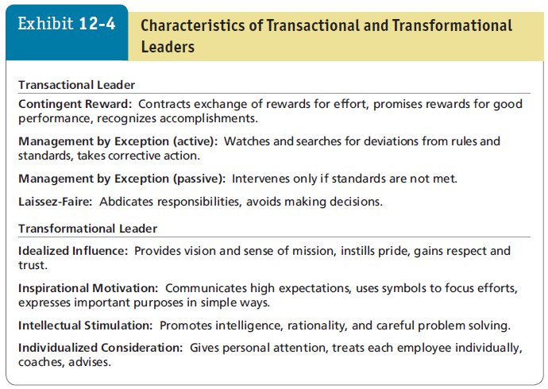

Contemporary Theories of Leadership
LO 4
transformational leadership builds on transactional leadership and produces levels of follower effort and performance beyond what transactional leadership alone can do.
inspire followers to transcend their own self- interests for the good of the organization. They change followers' awareness of issues
1
Notes:
A stream of research has focused on differentiating between transactional leaders and transformational leaders.
Transformational leaders inspire followers to transcend their own self-interests for the good of the organization. They change followers’ awareness of issues by helping them to look at old problems in new ways; and they are able to excite, arouse, and inspire followers to put out extra effort to achieve group goals.
Exhibit 12-4 shows that transformational leadership builds on transactional leadership and produces levels of follower effort and performance beyond what transactional leadership alone can do. Transactional and transformational leadership complement each other; they aren’t opposing approaches to getting things done. The best leaders are transactional and transformational.

Slide 26
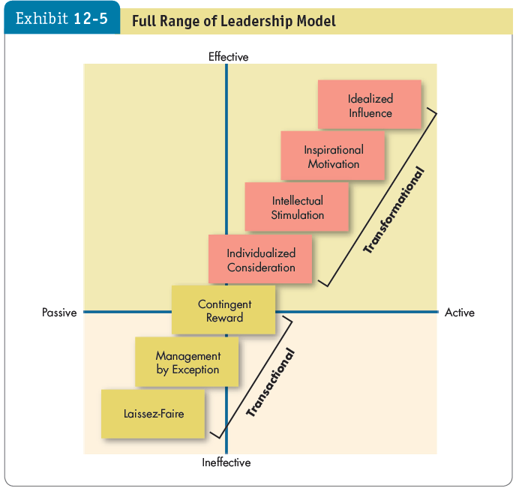

Contemporary Theories of Leadership
LO 4
1
Notes:
Exhibit 12-5 shows the full range of the leadership model.
Laissez-faire is the most passive and least effective type, while management by exception is slightly better. Contingent reward leadership can be effective, but will not get employees to go above and beyond the call of duty.
The remaining four correspond to transformational leadership: individualized consideration, intellectual stimulation, inspirational motivation, and idealized influence. Leaders are generally more effective when they regularly use the four I’s. Only with these styles are leaders able to motivate followers to perform above expectations and transcend their self-interests for the sake of the organization.

Slide 27







Contemporary Theories of Leadership
LO 4
How Transformational Leadership Works
Creativity – theirs and others.
Decentralization of responsibility.
Propensity to take risks.
Compensation is geared toward long-term results.
Greater agreement among top managers about the organization’s goals.
1
Notes:
Transformational leaders are more effective because they are more creative, but also because they encourage those who follow them to be creative, too. Companies with transformational leaders have greater decentralization of responsibility, managers have more propensity to take risks, and compensation plans are geared toward long-term results—all of which facilitate corporate entrepreneurship.
One study of information technology workers in China found empowering leadership behavior led to feelings of positive personal control among workers, which increased their creativity at work.
Companies with transformational leaders also show greater agreement among top managers about the organization’s goals, which yields superior organizational performance.
The Israeli military has seen similar results, showing that transformational leaders improve performance by building consensus among group members. Transformational leaders are able to increase follower self-efficacy, giving the group a “can do” spirit.

Slide 28


Contemporary Theories of Leadership
LO 4
Evaluation of Transformational Leadership
Transformational leadership has been supported at diverse job levels and occupations, but isn’t equally effective in all situations.
It has a greater impact on the bottom line in smaller, privately-held firms than in more complex organizations.
1
Notes:
Transformational leadership has been supported at diverse job levels and occupations (school principals, teachers, marine commanders, ministers, presidents of MBA associations, military cadets, union shop stewards, sales reps), but it isn’t equally effective in all situations.
Transformational leadership has a greater impact on the bottom line in smaller, privately-held firms than in more complex organizations. The personal nature of transformational leadership may be most effective when leaders can directly interact with the workforce and make decisions than when they report to an external board of directors or deal with a complex bureaucratic structure. Another study showed transformational leaders were more effective in improving group potency in teams higher in power distance and collectivism.
Other recent research using a sample of employees both in China and the United States found that transformational leadership had a more positive relationship with perceived procedural justice among individuals who were lower in power-distance orientation, which in turn related to a stronger transformational leadership-citizenship behavior relationship among those higher in power distance.
Another study looking at employee creativity and transformational leadership more directly found employees with transformational leaders had more confidence in their ability to be creative at work and higher levels of creative performance.
A review of 117 studies testing transformational leadership found it was related to higher levels of individual follower performance, team performance, and organizational performance.
In addition, the GLOBE study of 18,000 leaders from 825 organizations in 62 countries links a number of elements of transformational leadership with effective leadership, regardless of country.

Slide 29


Contemporary Theories of Leadership
LO 4
Transformational versus Transactional Leadership
Transformational leadership is more strongly correlated with lower turnover rates, higher productivity, lower employee stress and burnout, and higher employee satisfaction.
1
Notes:
When comparing transformational leadership with transactional leadership, research indicates transformational leadership is more strongly correlated than transactional leadership with lower turnover rates, higher productivity, lower employee stress and burnout, and higher employee satisfaction.
However, transformational leadership theory is not perfect. The full range of leadership model shows a clear division between transactional and transformational leadership that may not fully exist in effective leadership.
And contrary to the full range of leadership model, the four I’s of transformational leadership are not always superior in effectiveness to transactional leadership; contingent reward leadership, in which leaders dole out rewards as certain goals are reached by employees, sometimes works as well as transformational leadership.
More research is needed, but the general supportable conclusion is that transformational leadership is desirable and effective, given the right application.

Slide 30


Contemporary Theories of Leadership
LO 4
Transformational versus Charismatic Leadership
Charismatic leadership places more emphasis on the way leaders communicate – are they passionate and dynamic?
Transformational leadership focuses more on what they are communicating – is it a compelling vision?
Both focus on the leader’s ability to inspire followers.
1
Notes:
Charismatic leadership places somewhat more emphasis on the way leaders communicate (are they passionate and dynamic?), while transformational leadership focuses more on what they are communicating (is it a compelling vision?).
Still, the theories are more alike than different. At their heart, both focus on the leader’s ability to inspire followers, and sometimes they do so in the same way. Because of this, some researchers believe the concepts are somewhat interchangeable.

Slide 31


Role of Leaders in Creating Ethical Organizations
LO 5
Authentic Leadership
Authentic leaders:
Know who they are.
Know what they believe in and value.
Act on those values and beliefs openly and candidly.
The result: people come to have faith in them.
1
Notes:
What is authentic leadership? Authentic leaders know who they are. They know what they believe in and value. And they act on those values and beliefs openly and candidly. The result: people come to have faith in them.
Recent research indicates that authentic leadership, especially when shared among top management team members, created a positive energizing effect that heightened firm performance.

Slide 32




Role of Leaders in Creating Ethical Organizations
LO 5
Ethical Leadership
Ethics touches on leadership at a number of junctures.
Efforts have been made to combine ethical and charismatic leadership into an idea of socialized charismatic leadership – leadership that conveys other-centered values by leaders who model ethical conduct.
1
Notes:
Ethics touches on leadership at a number of junctures. Leaders who treat their followers with fairness, especially by providing honest, frequent, and accurate information, are seen as more effective.
Leaders must be willing to express their ethical beliefs and persuade others to follow their standards. To convey their beliefs, leaders should learn to express their moral convictions in statements that reflect values shared with their organization’s members. Leaders need to set high ethical standards, demonstrate them through their own behavior, and encourage and reward integrity in others while avoiding abuses of power.
Efforts have been made by scholars to combine ethical and charismatic leadership into an idea of socialized charismatic leadership – leadership that conveys other-centered (not self-centered) values by leaders who model ethical conduct.

Slide 33
Role of Leaders in Creating Ethical Organizations
LO 5
Servant Leadership
Servant leaders go beyond their self-interest and instead focus on opportunities to help followers grow and develop.
Characteristic behaviors include listening, empathizing, persuading, accepting stewardship, and actively developing followers’ potential.
1
Notes:
Scholars have recently considered ethical leadership from a new angle by examining servant leadership. Because servant leadership focuses on serving the needs of others, research has focused on its outcomes for the well-being of followers.
Characteristic behaviors include listening, empathizing, persuading, accepting stewardship, and actively developing followers’ potential.
This relationship between servant leadership and follower OCB appears to be stronger when followers are focused on being dutiful and responsible. Second, servant leadership increases team potency (a belief that one’s team has above-average skills and abilities), which in turn leads to higher levels of group performance. Third, a study with a nationally representative sample found higher levels of citizenship associated with a focus on growth and advancement, which in turn was associated with higher levels of creative performance.
Servant leadership may be more prevalent and more effective in certain cultures. When asked to draw images of leaders, U.S. subjects tend to draw them in front of the group, giving orders to followers. Singaporeans tend to draw leaders at the back of the group, acting more to gather a group’s opinions together and then unify them from the rear. This suggests the East Asian prototype is more like a servant leader, which might mean servant leadership is more effective in these cultures.

Slide 34

Positive Leadership
LO 6
Trust and Leadership
Trust: a psychological state that exists when you agree to make yourself vulnerable to another because you have positive expectations about how things are going to turn out.
A primary attribute associated with leadership.
When trust is broken, it can have serious adverse effects on a group’s performance.
1
Notes:
Trust is a psychological state that exists when you agree to make yourself vulnerable to another because you have positive expectations about how things are going to turn out. Trust is a primary attribute associated with leadership. When trust is broken, it can have serious adverse effects on a group’s performance. People are unlikely to look up to or follow someone they perceive as dishonest or likely to take advantage of them. Thus, as you might expect, transformational leaders do generate higher levels of trust from their followers, which in turn is related to higher levels of team confidence and, ultimately, higher levels of team performance.

Slide 35
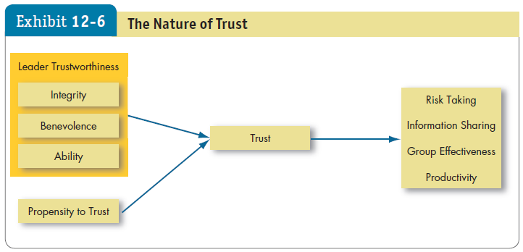
Positive Leadership
LO 6
1
Notes:
Trust isn’t just about the leader; the characteristics of the followers will also influence the development of trust. What key characteristics lead us to believe a leader is trustworthy? Exhibit 12-6 shows three characteristics: integrity, benevolence, and ability.
Integrity refers to honesty and truthfulness. It seems the most critical of the three in assessing another’s trustworthiness. Benevolence means the trusted person has your interests at heart, even if yours aren’t necessarily in line with theirs. Ability encompasses an individual’s technical and interpersonal knowledge and skills.
The Outcomes of Trust:
Trust encourages taking risks.
Whenever employees decide to deviate from the usual way of doing things, or to take their supervisors’ word on a new direction, they are taking a risk.
Trust facilitates information sharing.
One big reason employees fail to express concerns at work is that they don’t feel psychologically safe revealing their views.
Trusting groups are more effective.
When a leader sets a trusting tone in a group, members are more willing to help each other and exert extra effort, which further increases trust.
Trust enhances productivity.
The bottom-line interest of companies also appears positively influenced by trust. Employees who trust their supervisors tend to receive higher performance ratings.

Slide 36
Positive Leadership
LO 6
Trust propensity
Trust and Culture
The Role of Time
Regaining Trust
1
Notes:
Trust propensity refers to how likely a particular employee is to trust a leader. Some people are simply more likely to believe others can be trusted. Trust may be built on very different perceptions from culture to culture.
Time is the final ingredient in the recipe for trust. Trust doesn’t happen immediately: we come to trust people based on observing their behavior over a period of time. Trust can also be won in the ability domain simply by demonstrating competence.
Leaders who break the psychological contract with workers, demonstrating they aren’t trustworthy, will find that employees are less satisfied and less committed, have higher intentions to turnover, engage in less citizenship behavior, and have lower task performance.

Slide 37


Challenges to our Understanding of Leadership
LO 7
Much of an organization’s success or failure is due to factors outside the influence of leadership.
In many cases, success or failure is just a matter of being in the right or wrong place at a given time.
The attribution theory of leadership says leadership is merely an attribution people make about other individuals.
1
Notes:
Much of an organization’s success or failure is due to factors outside the influence of leadership. In many cases, success or failure is just a matter of being in the right or wrong place at a given time.
The attribution theory of leadership says leadership is merely an attribution people make about other individuals. Thus, we attribute to leaders intelligence, outgoing personality, strong verbal skills, aggressiveness, understanding, and industriousness. At the organizational level, we tend to see leaders, rightly or wrongly, as responsible for extremely negative or extremely positive performance.

Slide 38
Challenges to our Understanding of Leadership
LO 7
Online Leadership
Needs more research.
Today’s managers and employees are increasingly linked by networks rather than geographic proximity.
Online leaders have to think carefully about what actions they want their digital messages to initiate.
Identification-based trust is difficult to achieve without face-to-face interaction.
Writing skills are likely to become an extension of interpersonal skills.
1
Notes:
Today’s managers and employees are increasingly linked by online networks rather than geographic proximity. We propose that online leaders have to think carefully about what actions they want their digital messages to initiate. They confront unique challenges, the greatest of which appears to be developing and maintaining trust.
Identification-based trust, based on a mutual understanding of each other’s intentions and appreciation of the other’s wants and desires, is particularly difficult to achieve without face-to-face interaction. And online negotiations can also be hindered because parties express lower levels of trust. We tentatively conclude that good leadership skills will soon include the abilities to communicate support, trust, and inspiration through keyboarded words and accurately read emotions in others’ messages.
In electronic communication, writing skills are likely to become an extension of interpersonal skills.

Slide 39

Challenges to our Understanding of Leadership
LO 7
Selecting Leaders
Identifying effective leaders:
Review specific requirements for the position.
Consider personality tests to identify leadership traits.
Situation-specific experience is relevant.
Plan for a change in leadership.
1
Notes:
The process that organizations go through to fill management positions is essentially an exercise in trying to identify individuals who will be effective leaders. You might begin by reviewing the specific requirements for the position such as knowledge, skills, and abilities that are needed to do the job effectively. Personality tests can identify traits associated with leadership—extraversion, conscientiousness, and openness to experience. Also, candidates with high emotional intelligence should have an advantage, especially in situations requiring transformational leadership. Experience is a poor predictor of leader effectiveness, but situation-specific experience is relevant.
In addition, it’s important to plan for a change in leadership.

Slide 40

Challenges to our Understanding of Leadership
LO 7
Training Leaders
Leadership training is likely to be more successful with high self-monitors.
Teach implementation skills.
Teach trust building, mentoring, and situational-analysis.
Behavioral training through modeling exercises can increase an individual’s charismatic leadership qualities.
Review leadership after key organizational events.
Train in transformational leadership skills.
1
Notes:
Billions are spent on leadership training and development every year. Here are some things management can do to get the maximum effect from their leadership-training budgets:
Leadership training is likely to be more successful with individuals who are high self-monitors than with low self-monitors. Second, organizations can teach implementation skills. We also can teach skills such as trust building, mentoring, and situational-analysis skills. There is evidence suggesting that behavioral training through modeling exercises can increase an individual’s ability to exhibit charismatic leadership qualities. Recent research also indicates that leaders should engage in regularly reviewing their leadership after key organizational events as part of their development. Finally, leaders can be trained in transformational leadership skills that have bottom-line results.

